Slide 1
Spatiotemporal Remote Sensing, automated in-situ IoT sensors & ML to monitor and predict HABs and cyanotoxins. Case Study-Lake Victoria
Presenter:
Name: OKELLO, JACOB OKOMO
Reg. No: ENC222-0149/2017

Slide 2
Introduction
Move 1 establish your territory (say what the topic is about)
Move 2 establish a niche (show why there needs to be further research on your topic)
Move 3 introduce the current research (make hypotheses; state the research questions)
Start globally > regionally > nationally > locally outline the issue at hand.
What have other researchers said about this issue?
What has been done to solve this problem?

Slide 3
Problem statement
By now you’ve identified gaps in the past studies
Clearly outline it here
After reviewing the papers and gaps – what exactly is the problem? state this explicitly.
Ensure you mention the problem, area, and in detail the problem specifics

Slide 4
Justification
Outline why this research is important.
What benefits will the project bring?
What is the cost of not using this technology?
Try to get some facts on the actual negative cost e.g. delays in service, expense, etc
Focus on the good things that your new technologies will bring.

Slide 5
General and specific objectives
To monitor and predict the occurrence of Harmful Algal Blooms(HABs) and Cyanobacteria.
To develop automated in-situ Internet of Things(IoT) sensors to monitor the occurrence of the event.
To develop a system that reports specified geo-tagged data from the above sensors.
To associate Machine Learning models to predict the occurrence of CynoHAB.

Slide 6
To Predict occurrence of cyanobacterial and Harmful algal blooms in the Selected Lake.
To associate Automated Internet of Things (IoT) in situ sensors, machine learning Applicable in near real-time to enhance the accuracy and speed for in situ data analysis.
To develop a reporting system to alert on a short-term foreseen bloom.

Slide 7
Study Area

Slide 8
Data & Materials

Slide 9
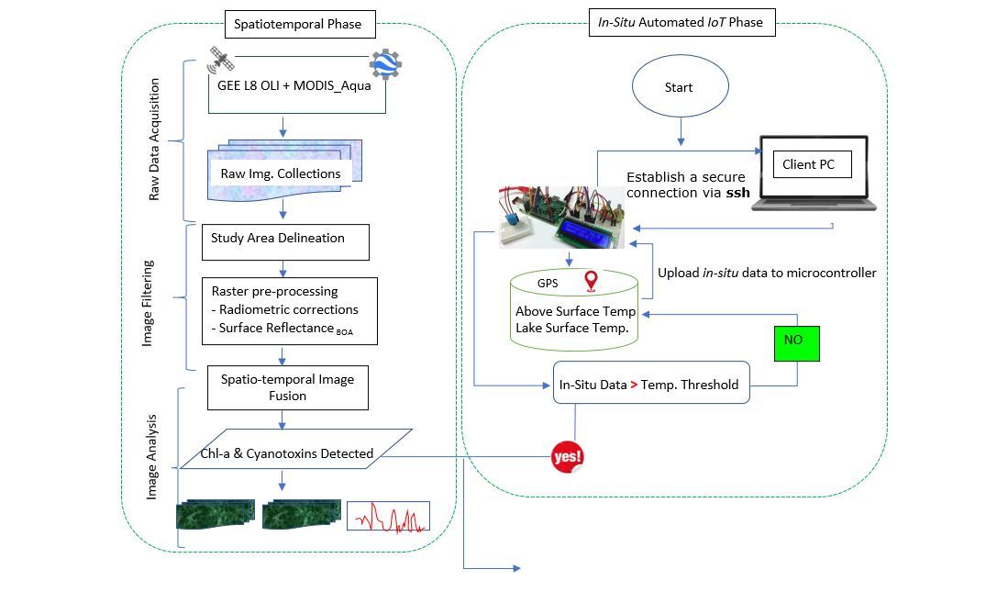
Overall methodology

Slide 10
Expected Results

Slide 11
Project Timeline

Slide 12

Thank you for your attention! Questions?

